Slide 1
The Guy That Does The Thing

Slide 2
A little about me
Graduated with PhD from Calgary (2005)
Started Postdoc in Michigan (2005-2013)
Started Looking for Jobs in 2011
Hired at UTHSC in 2012, started in 2013
On Hiring Committee for Pediatric Obesity Program

Slide 3
What is the next career stage
For many of you its postdoctoral training
For how long and in what?

Slide 4
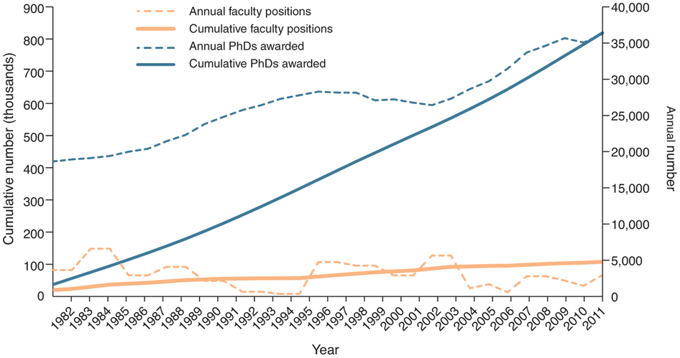
Total Number of Trainees
Schillebeeckx M, Maricque B, Lewis C 2013 The missing piece to changing the university culture. Nat. Biotechnol. Nature Publishing Group; 31:938–941

Slide 5
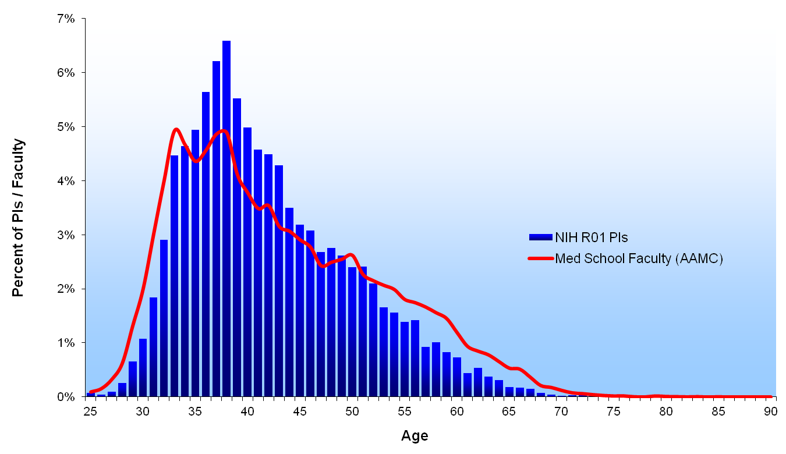
1980

Slide 6
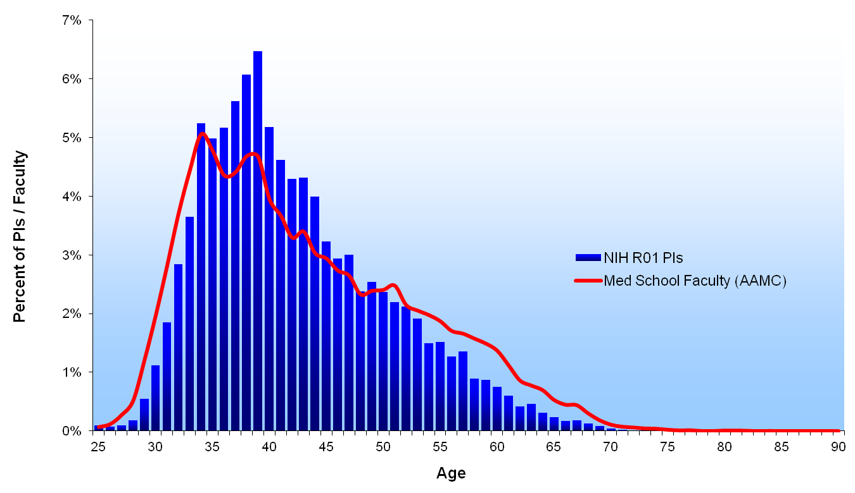
1981

Slide 7
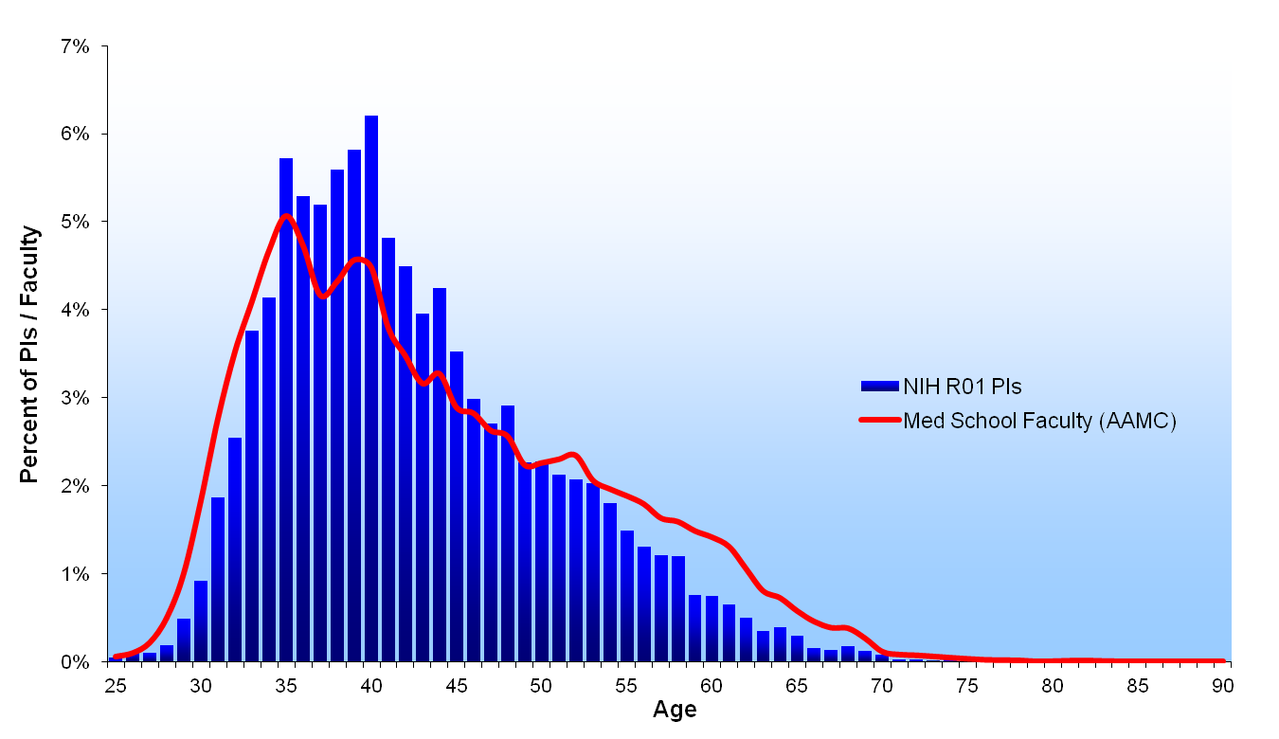
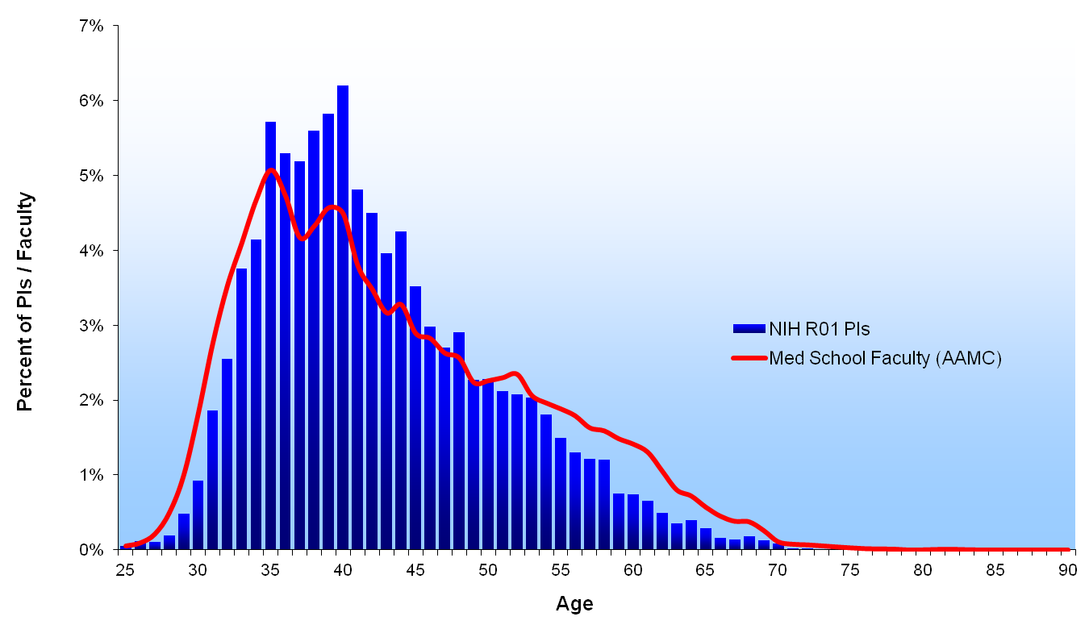
1982

Slide 8
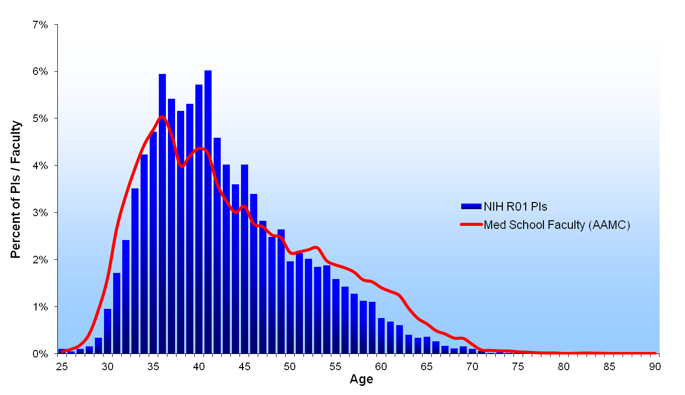
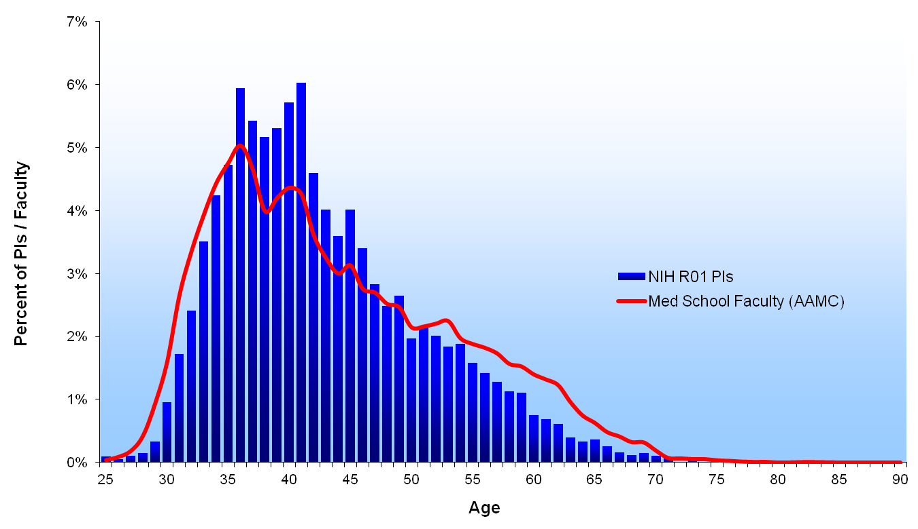
1983

Slide 9

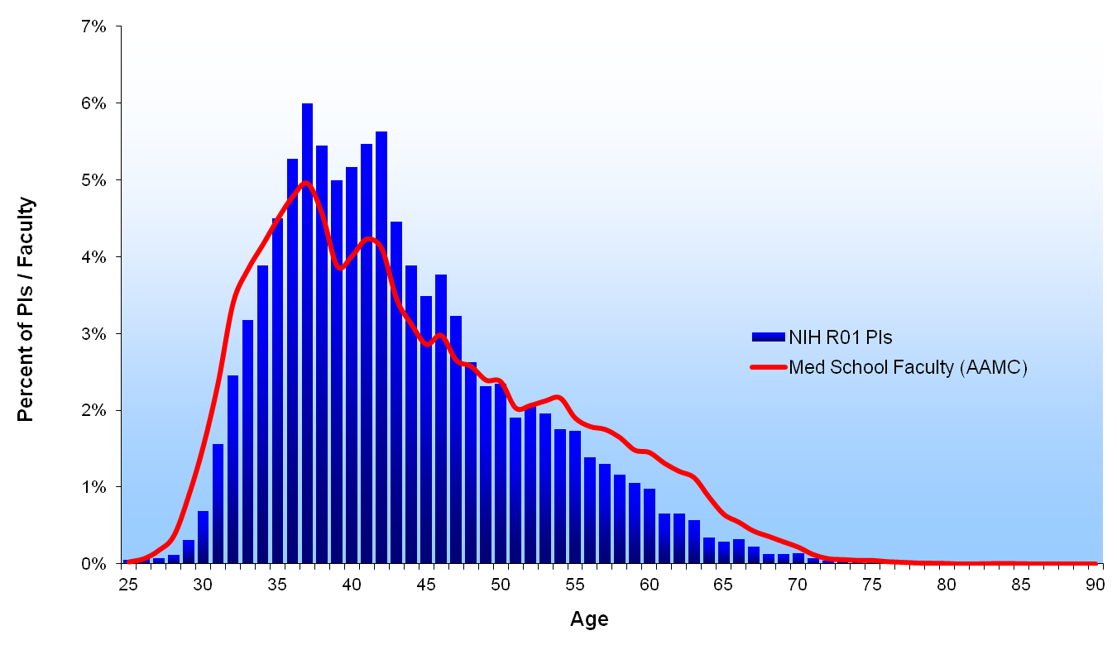
1984

Slide 10
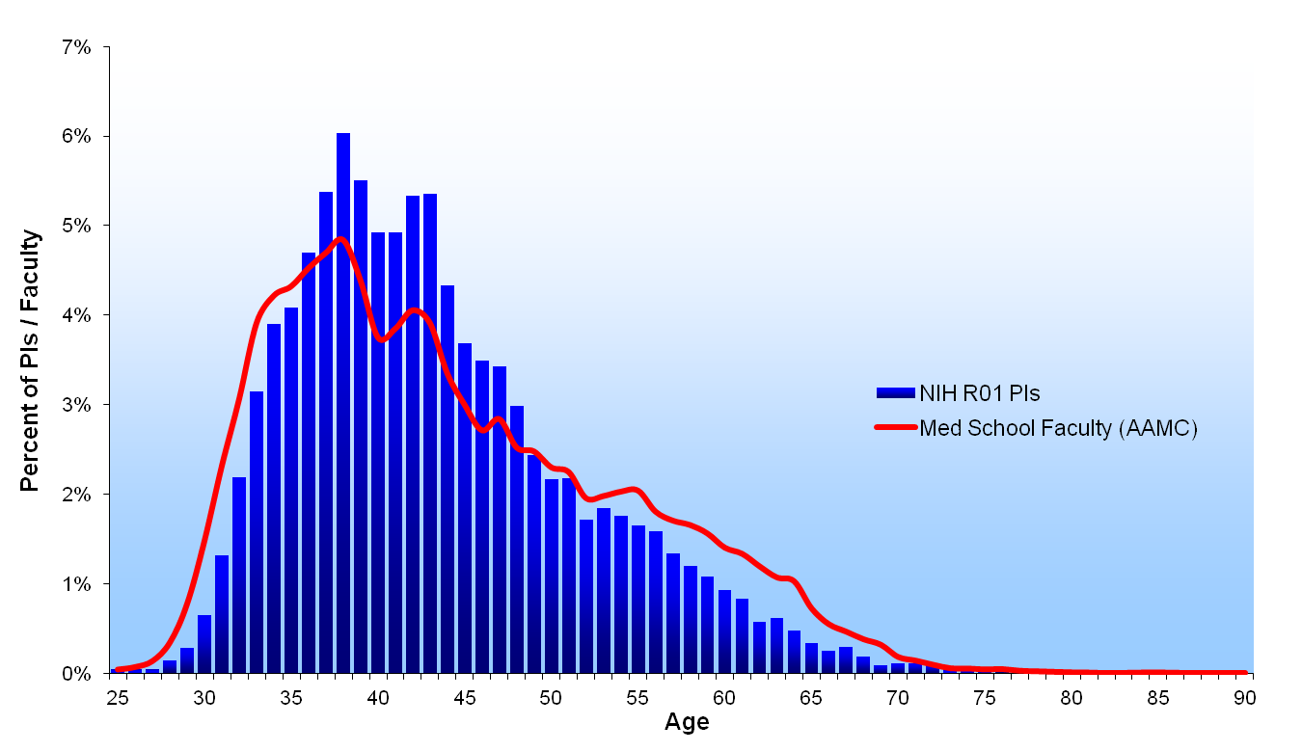
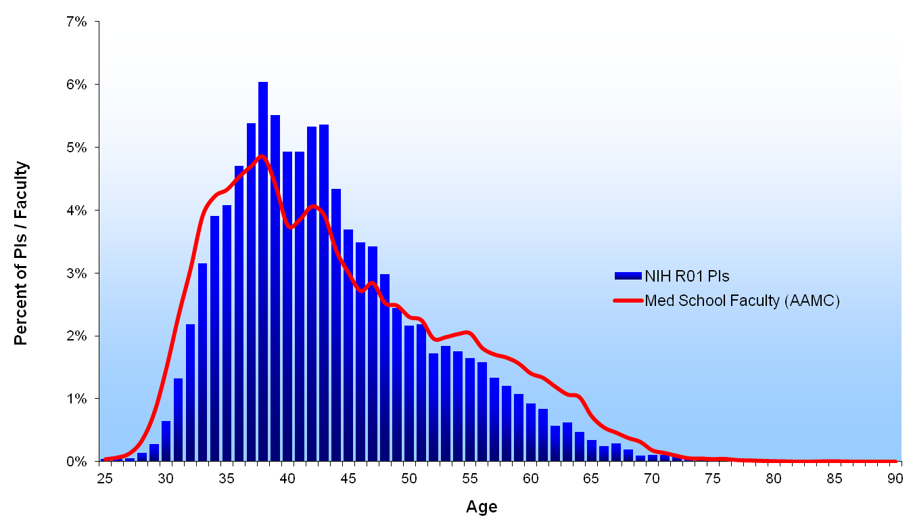
1985

Slide 11
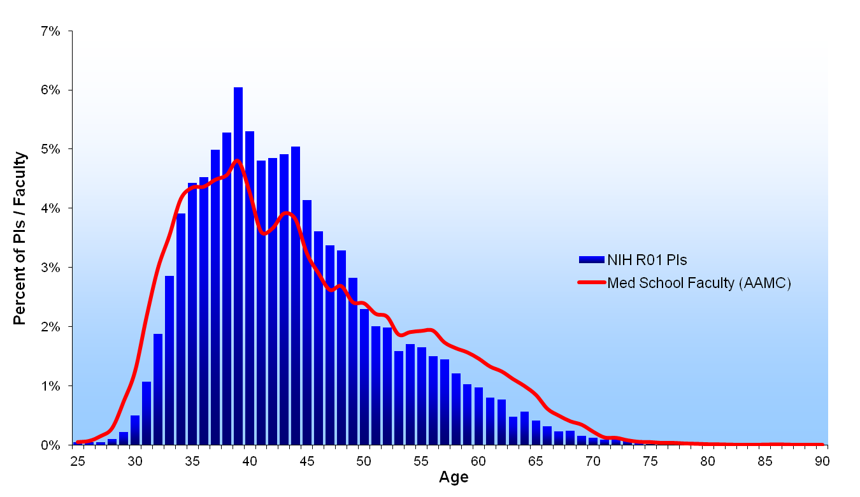

1986

Slide 12
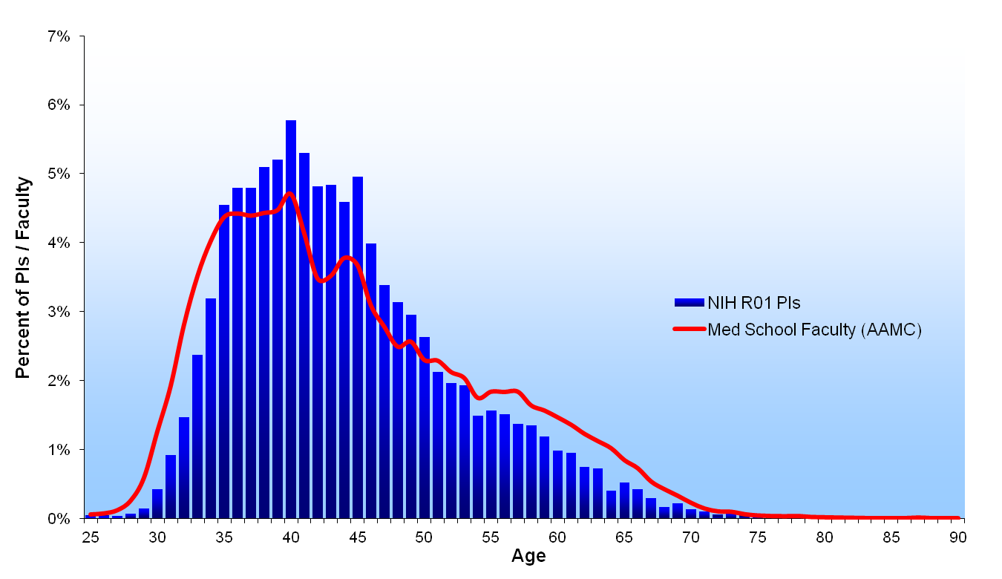
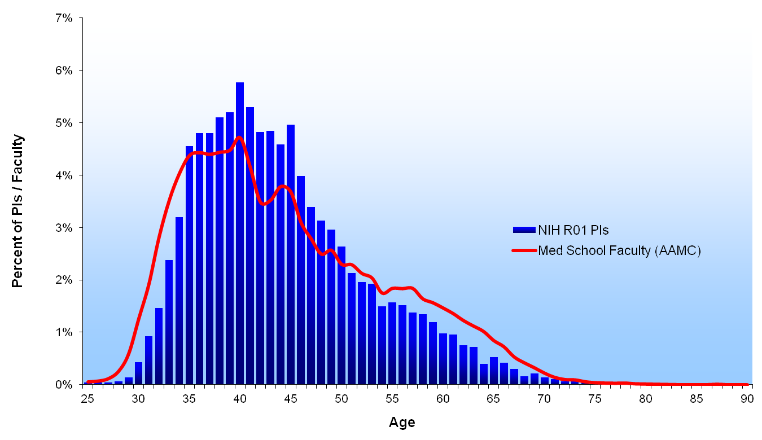
1987

Slide 13
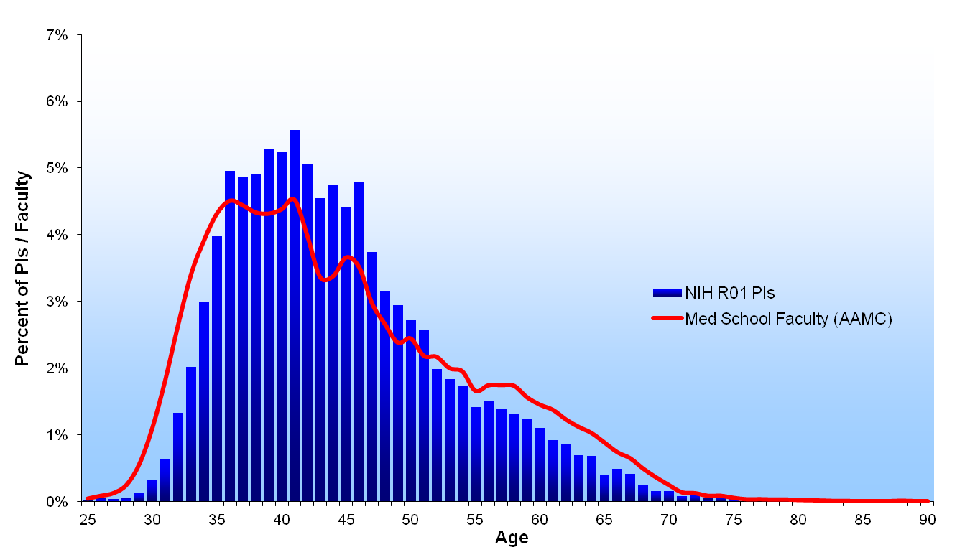
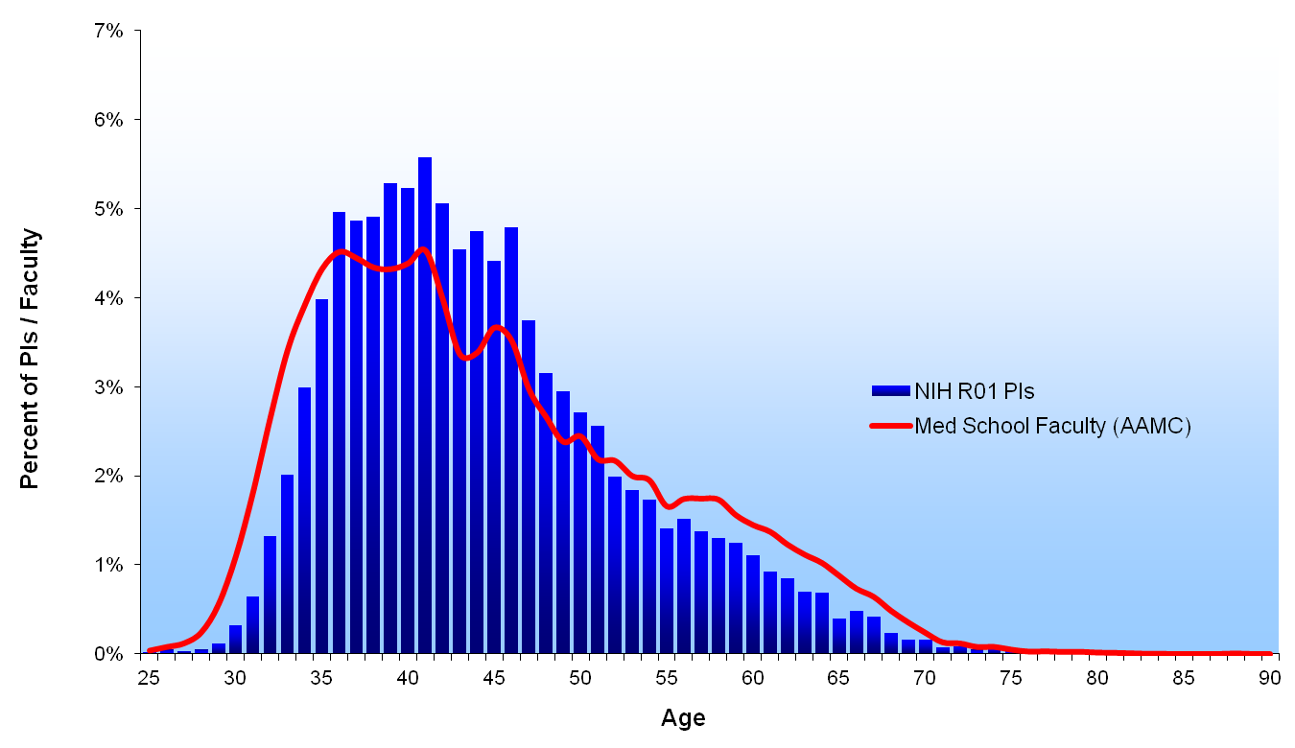
1988

Slide 14
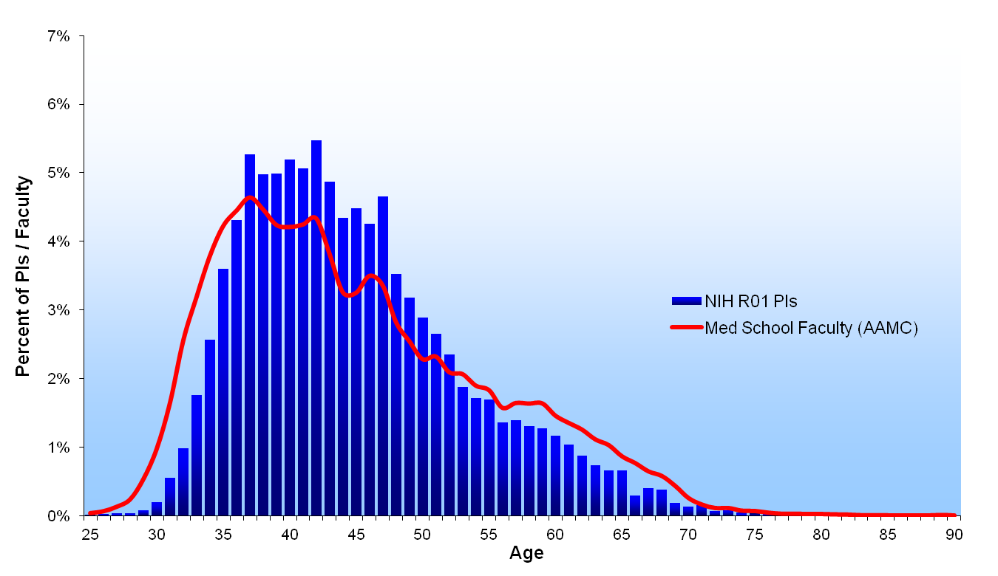

1989

Slide 15


1990

Slide 16
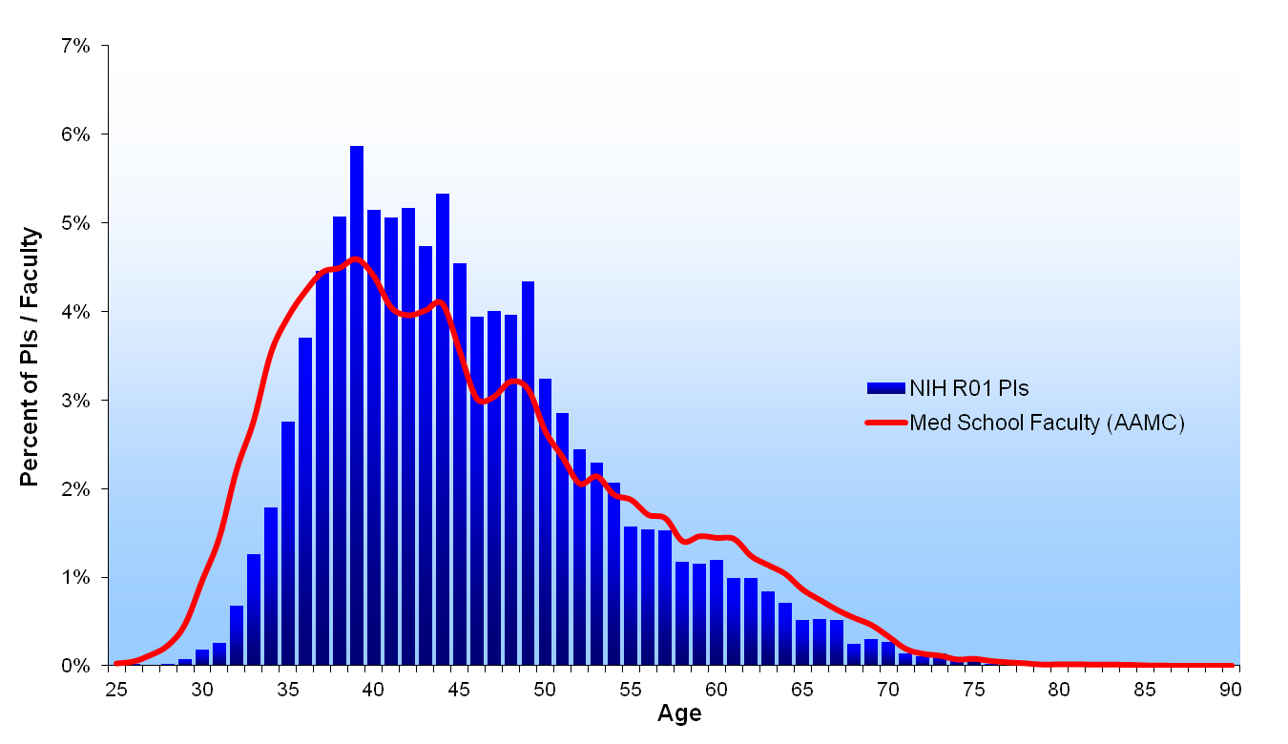

1991

Slide 17
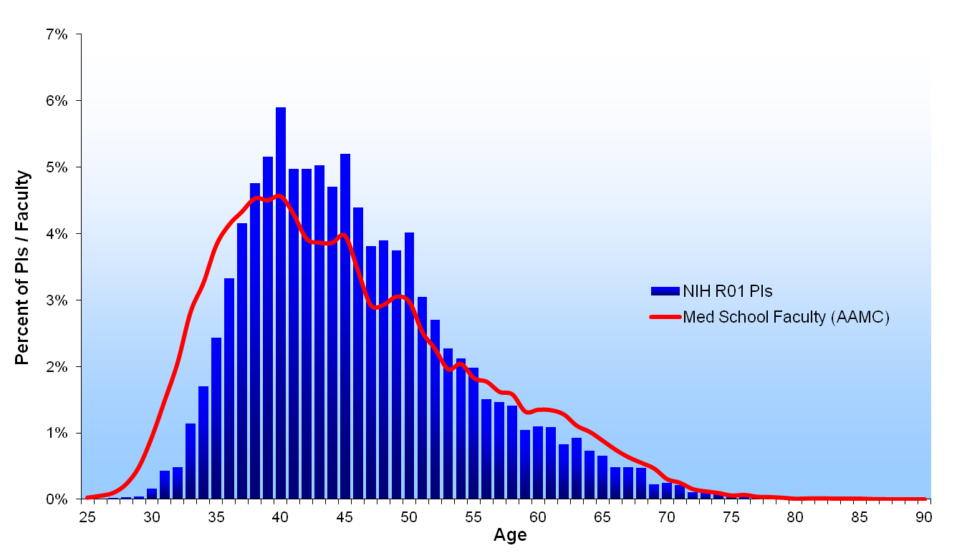

1992

Slide 18
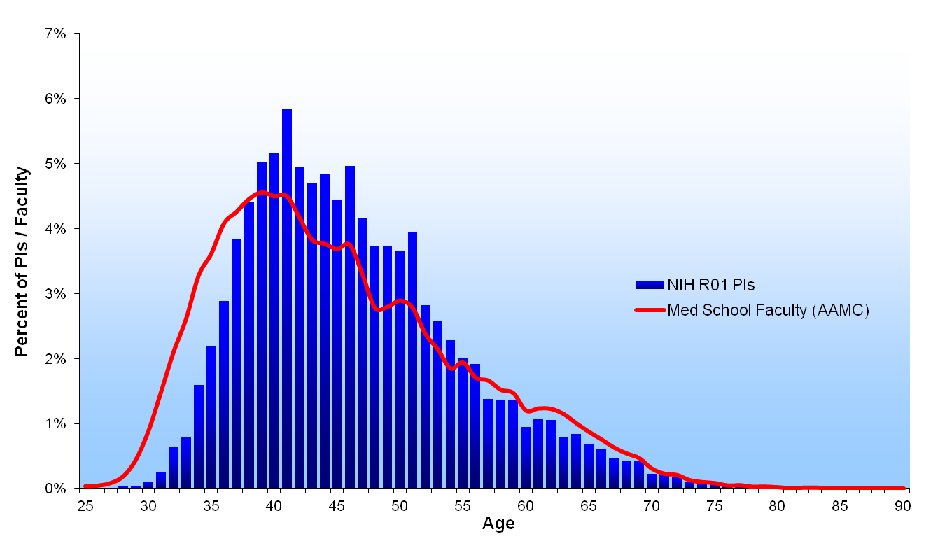
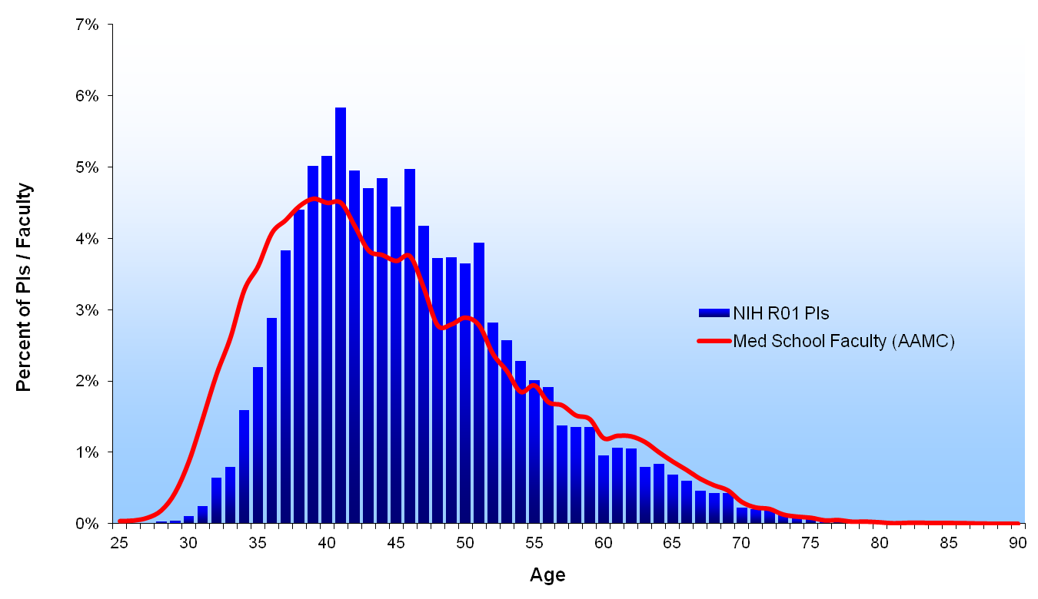
1993

Slide 19


1994

Slide 20
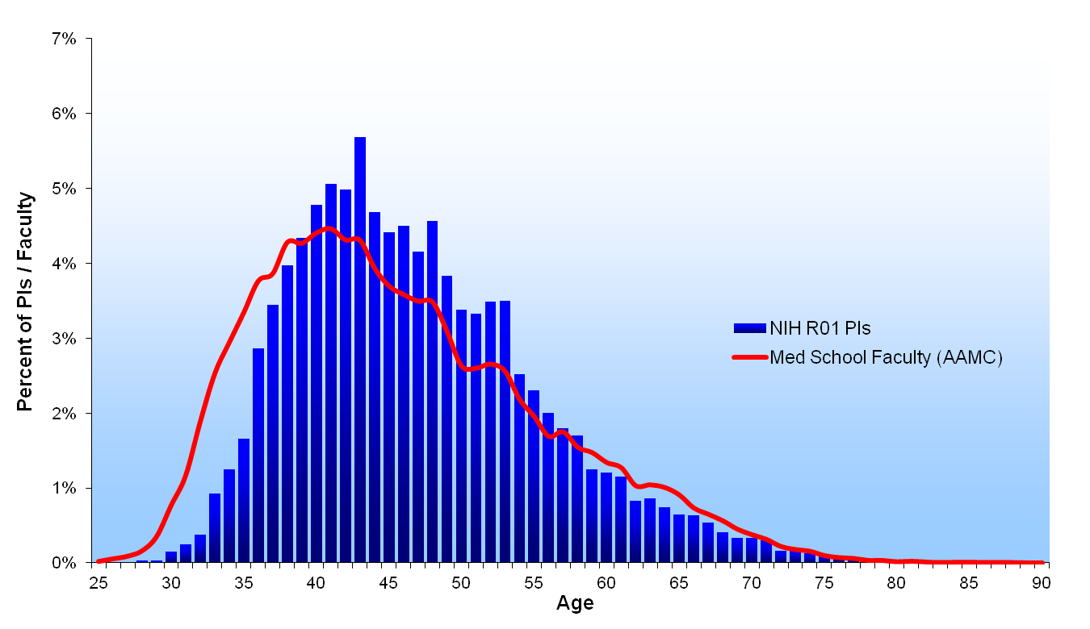

1995

Slide 21
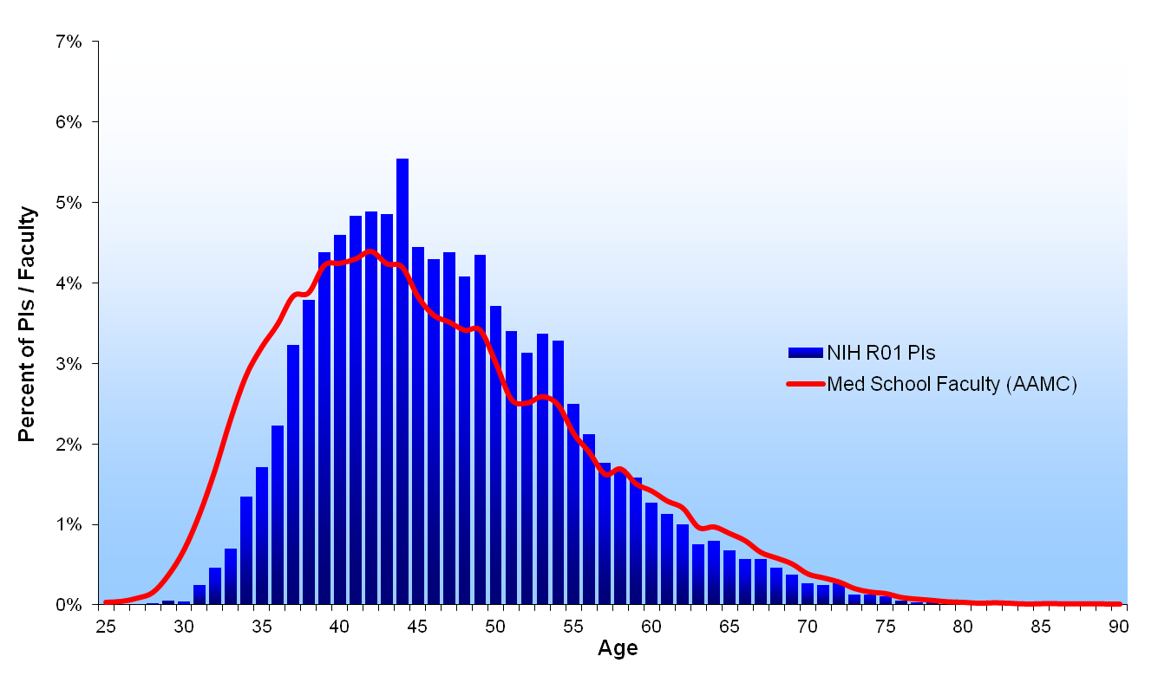
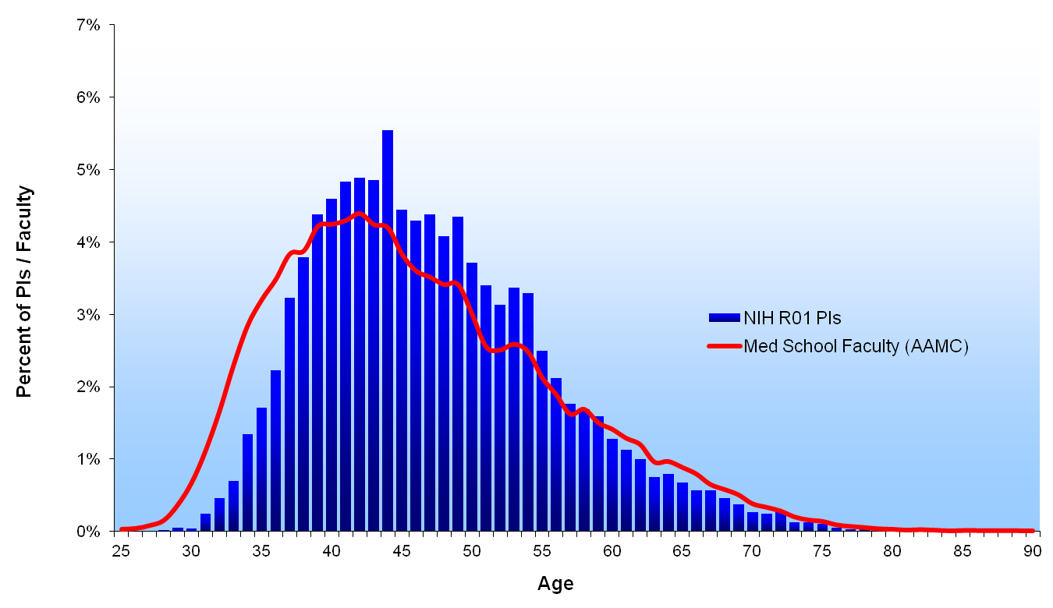
1996

Slide 22
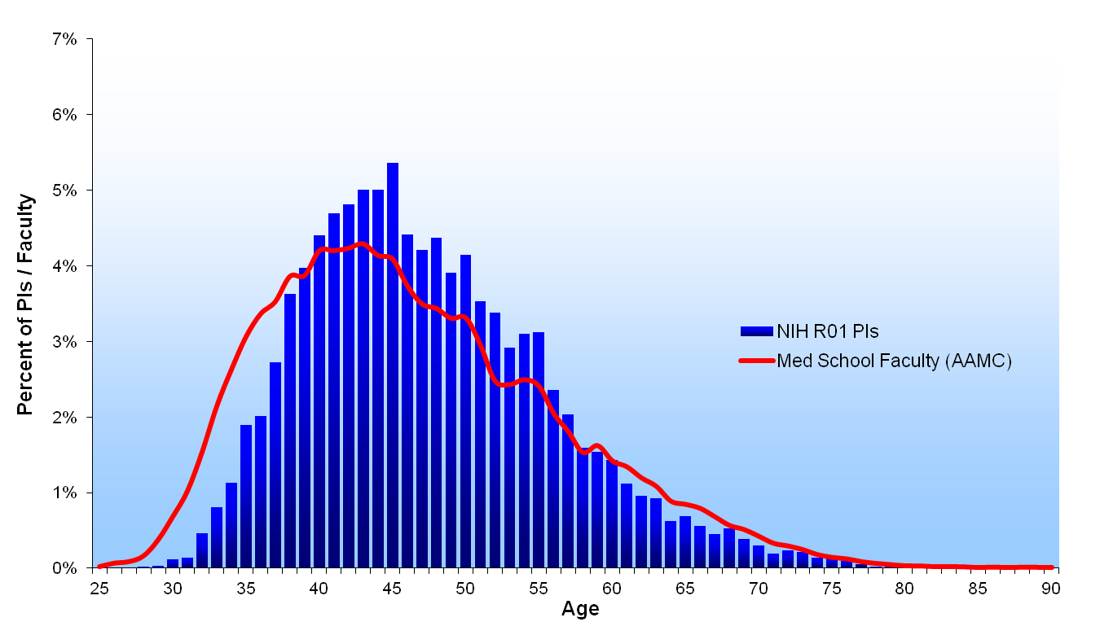
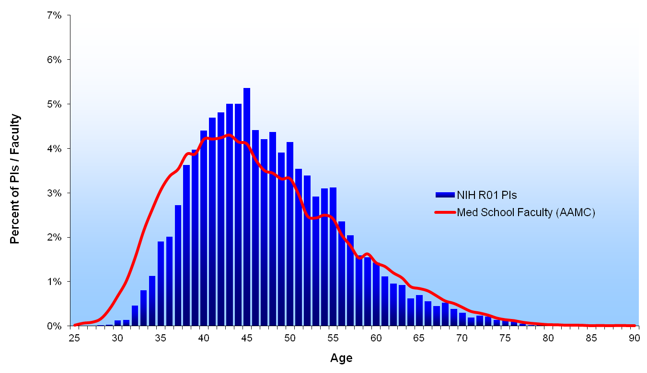
1997

Slide 23
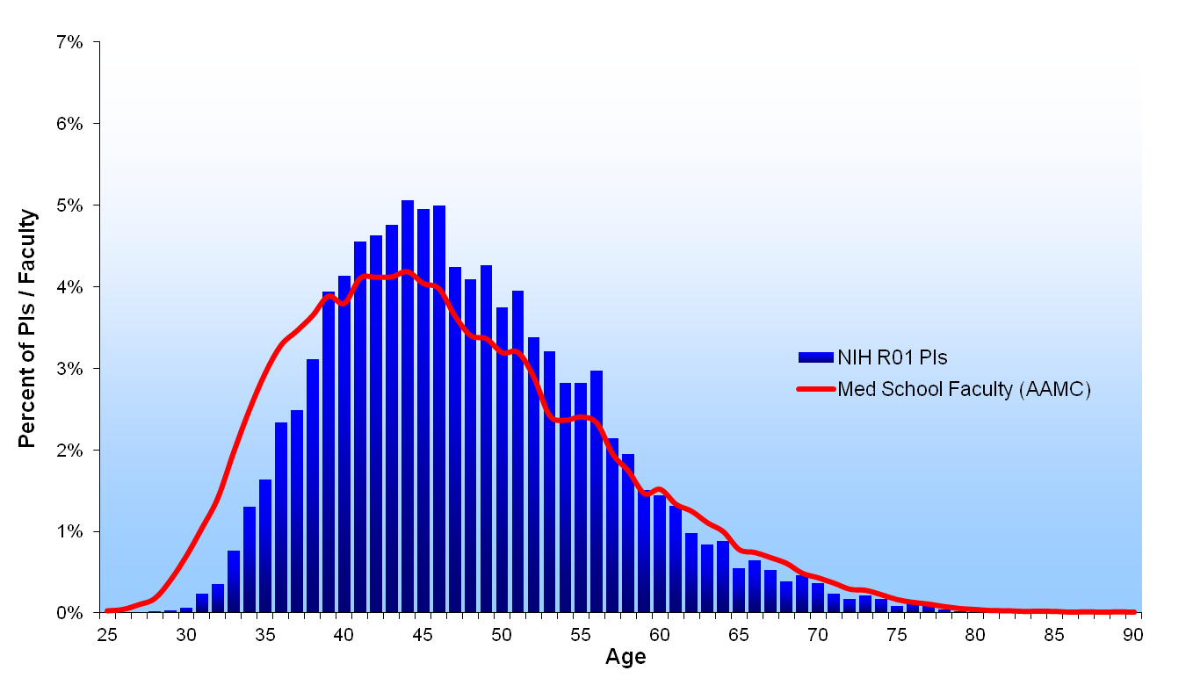
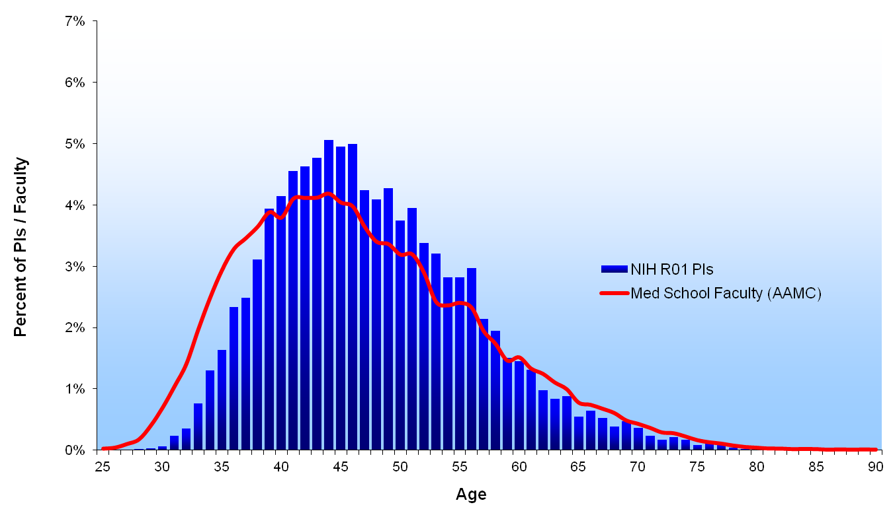
1998

Slide 24

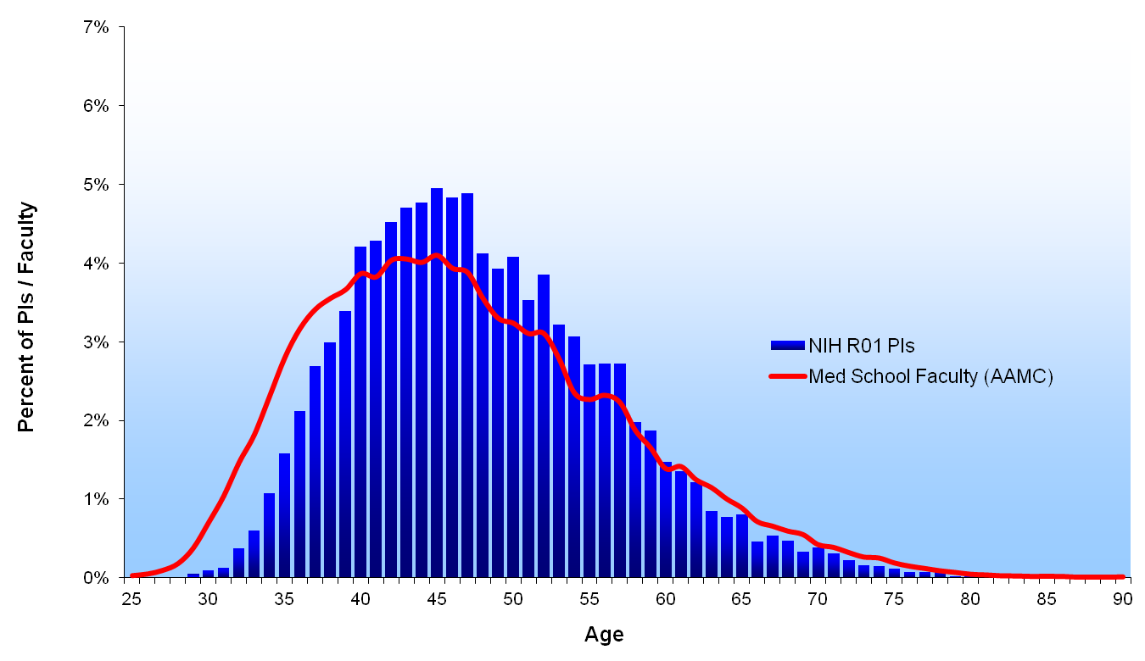
1999

Slide 25

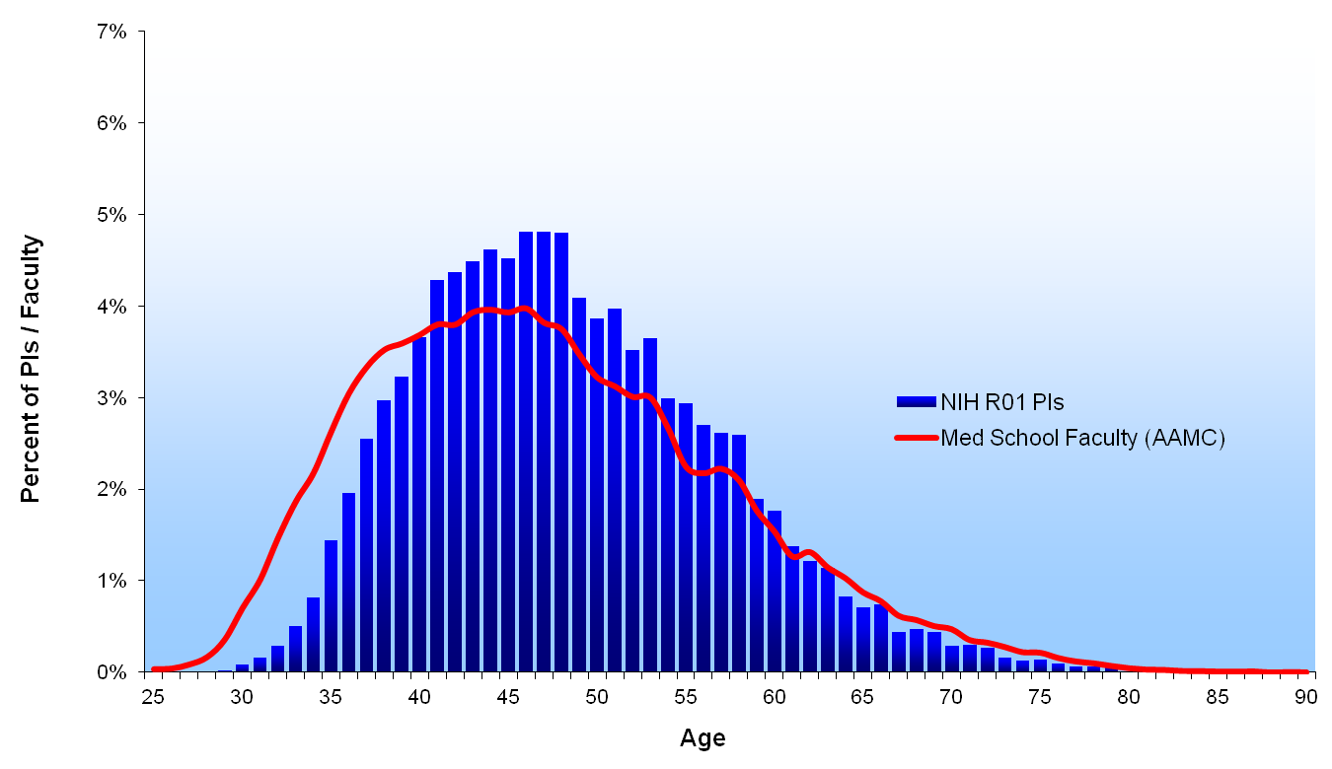
2000

Slide 26

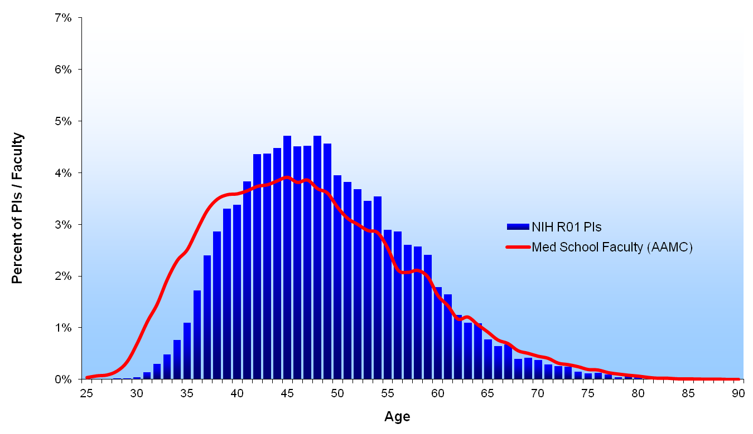
2001

Slide 27
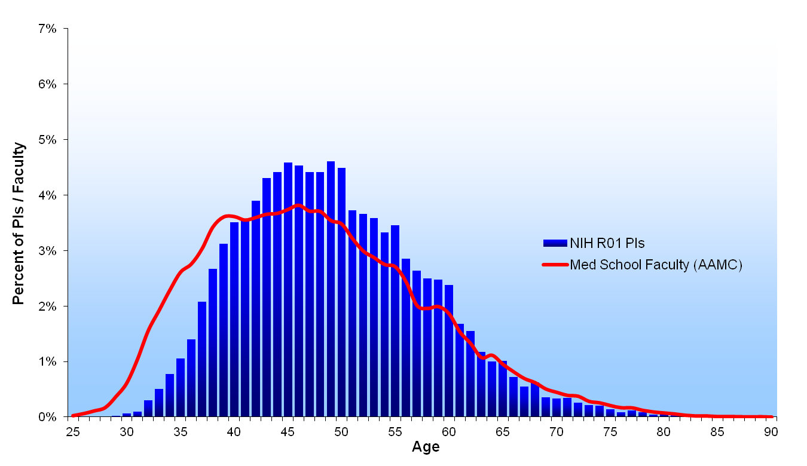

2002

Slide 28
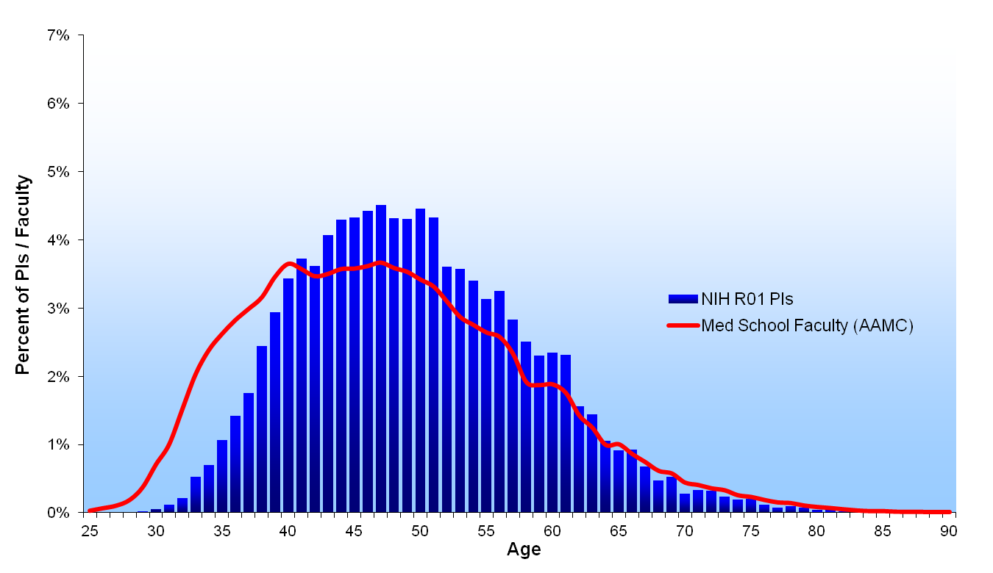
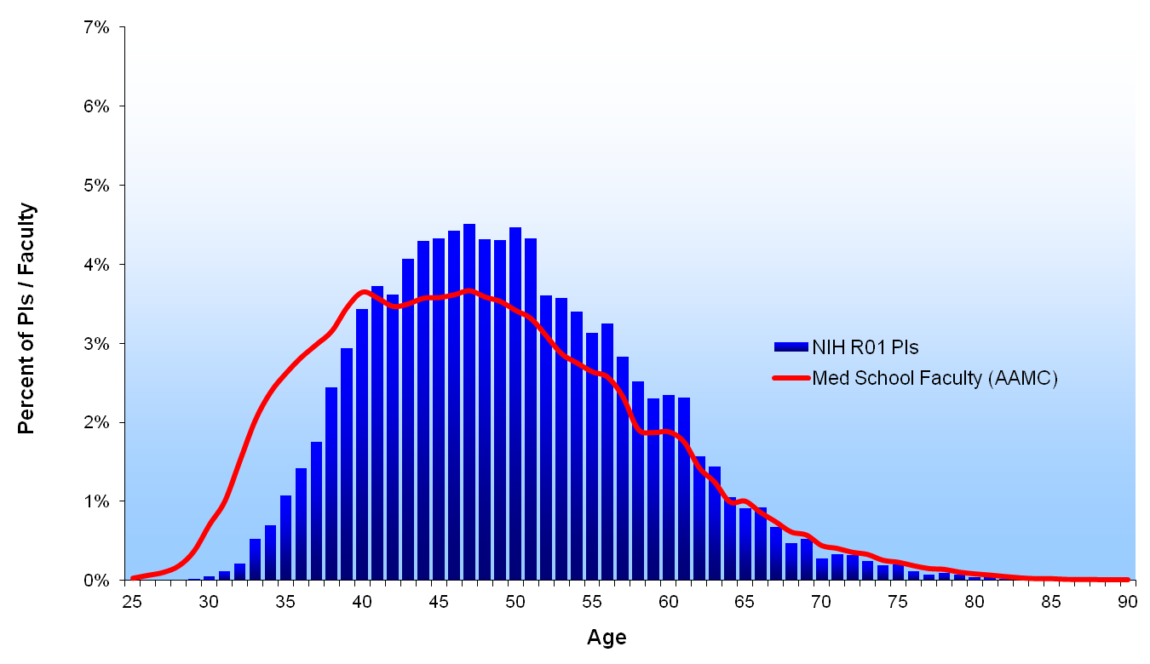
2003

Slide 29
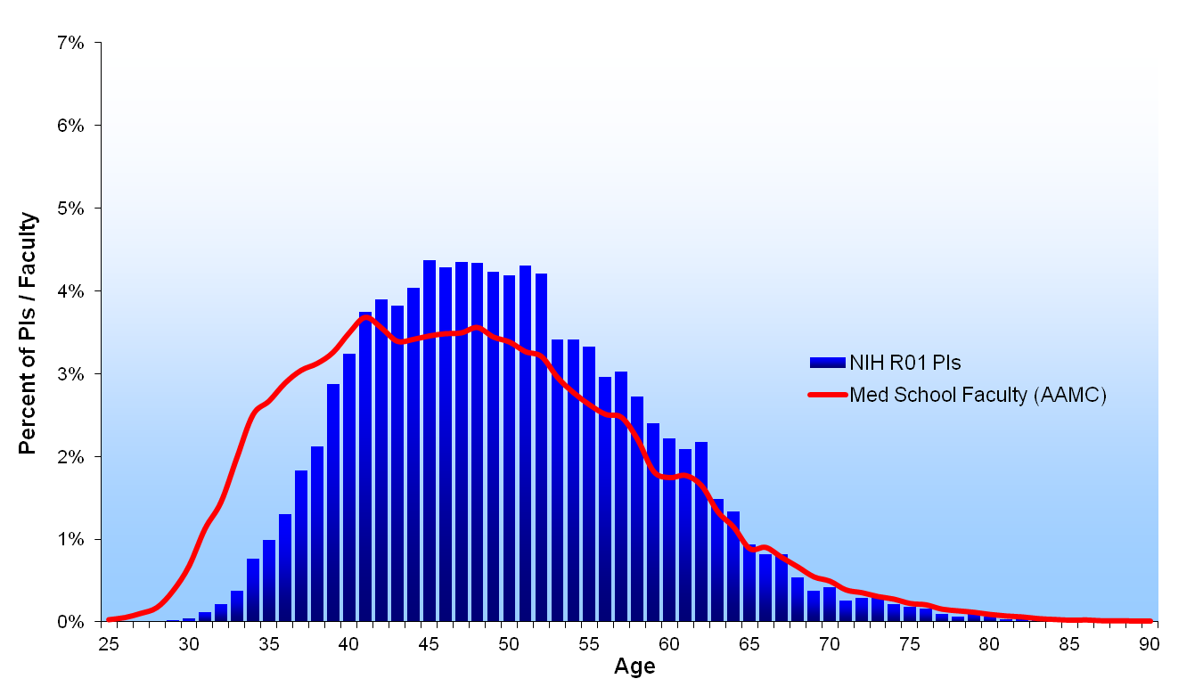
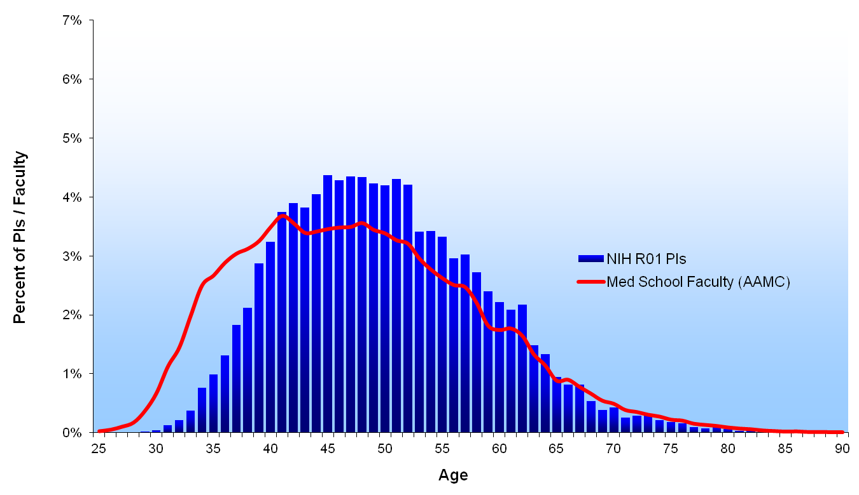
2004

Slide 30

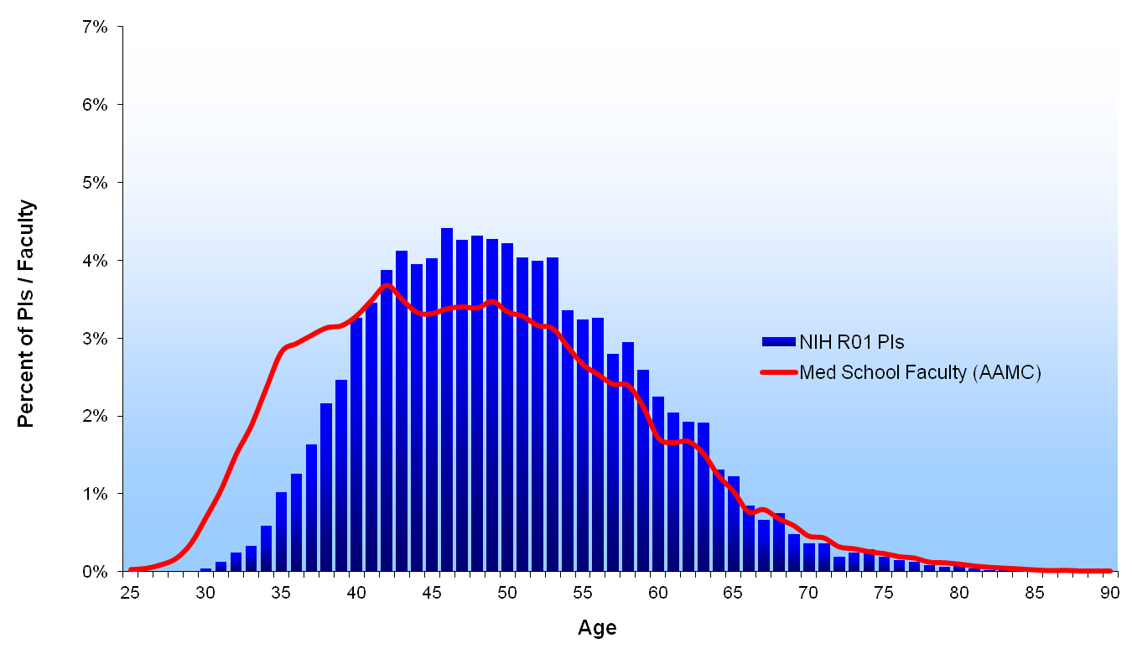
2005

Slide 31
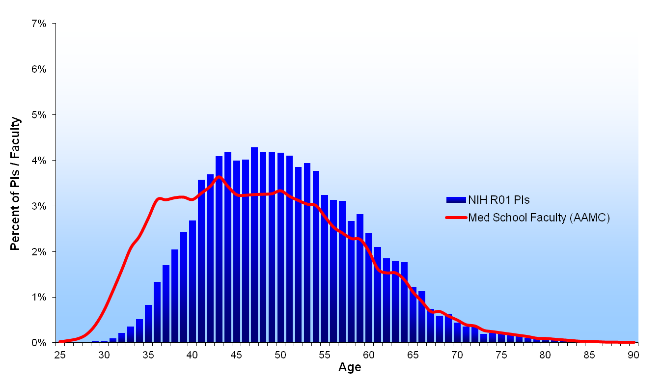
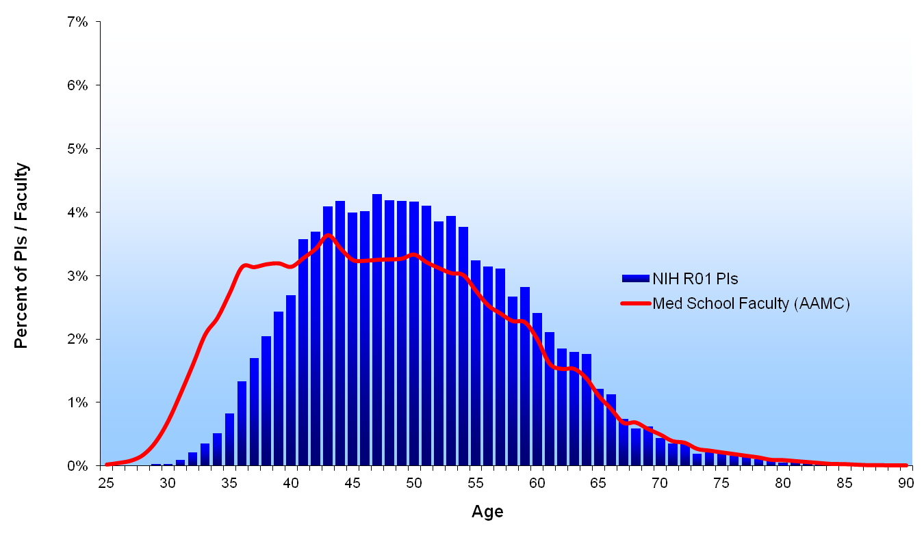
2006

Slide 32
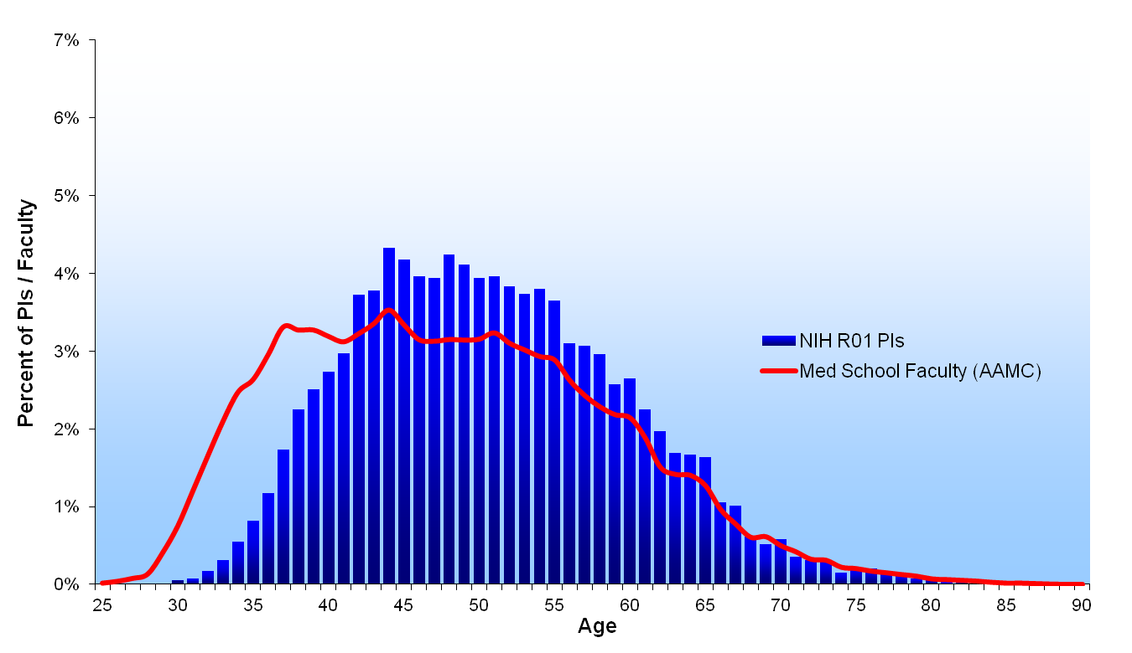
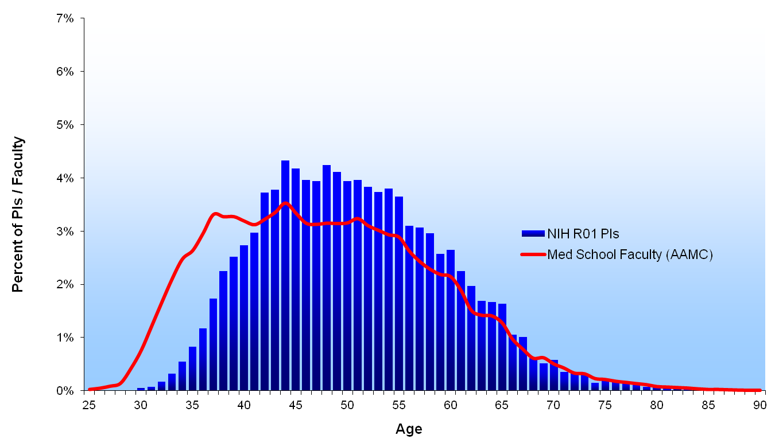
2007

Slide 33
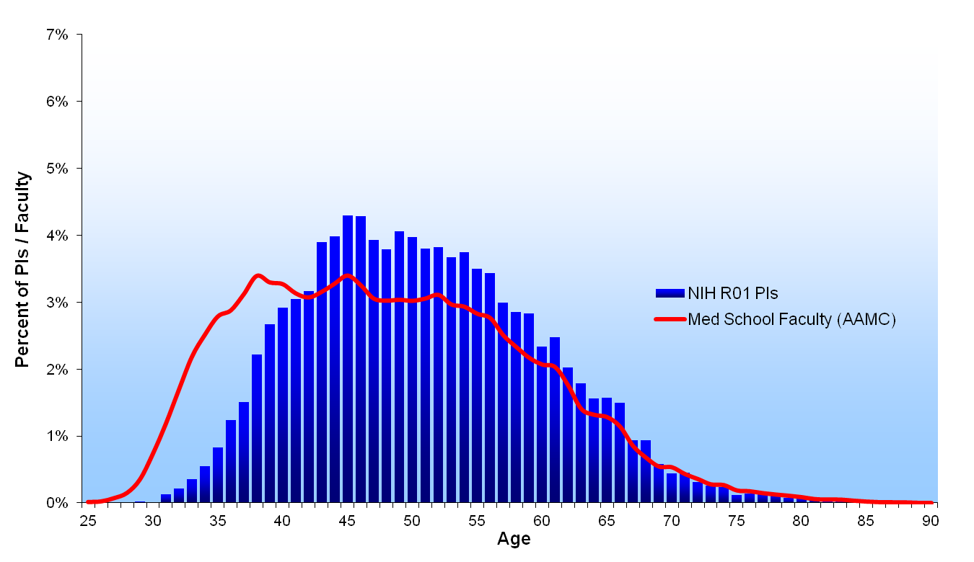
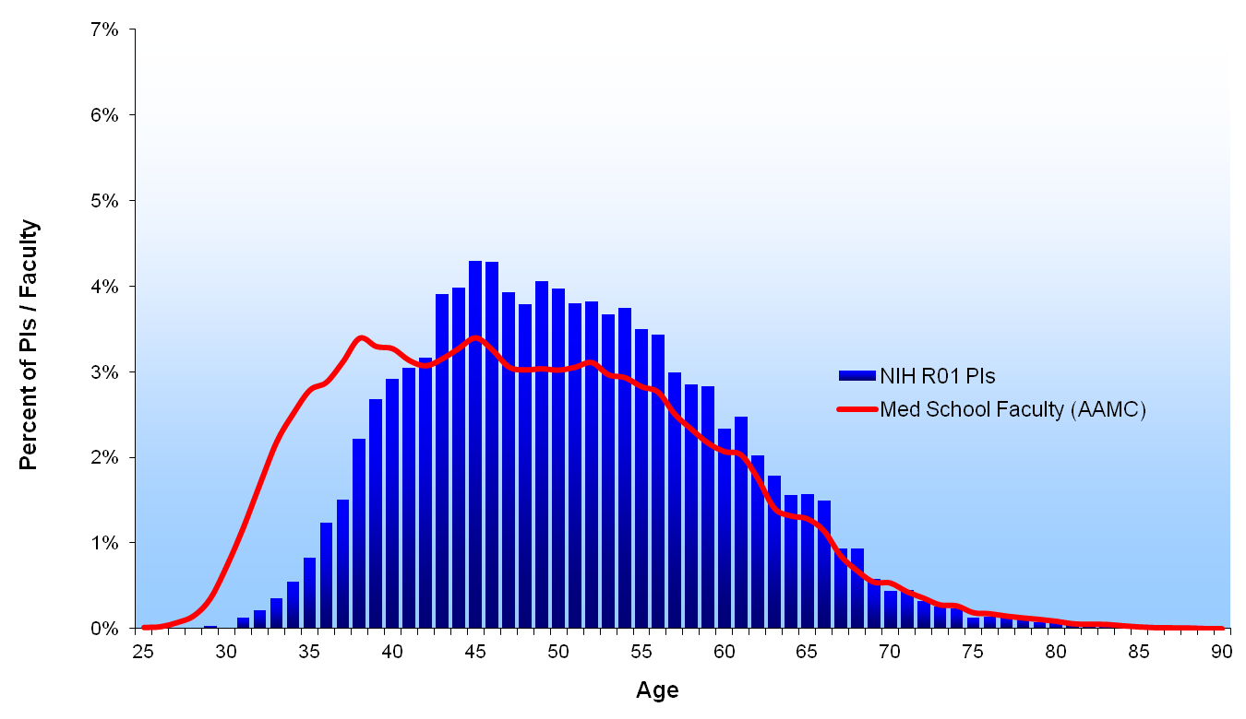
2008

Slide 34
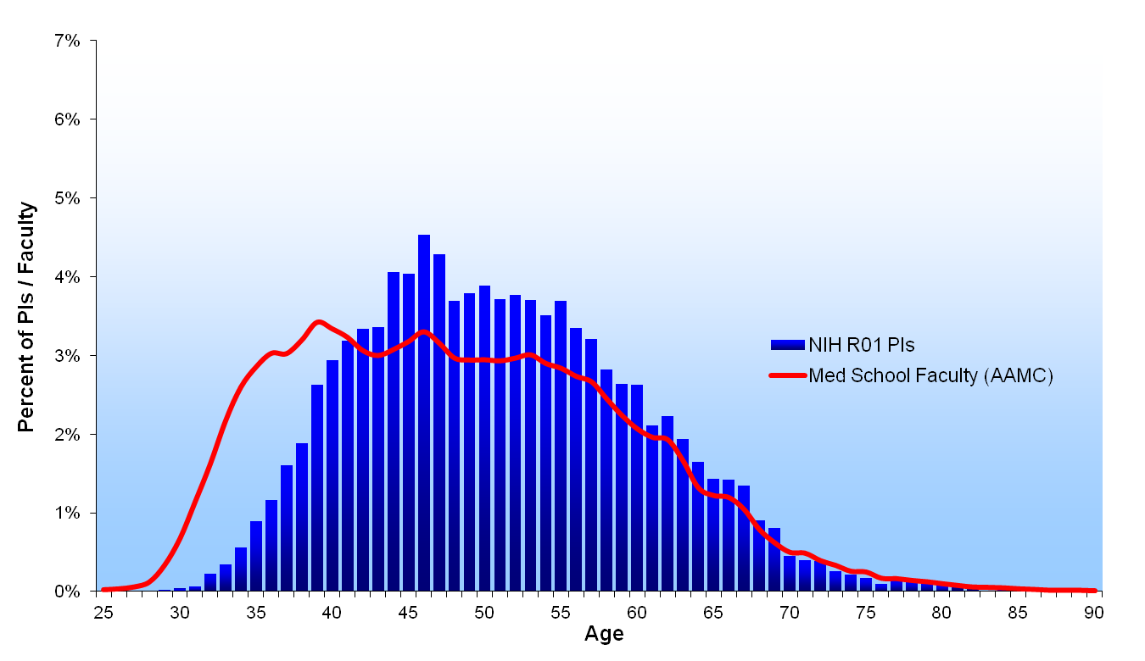
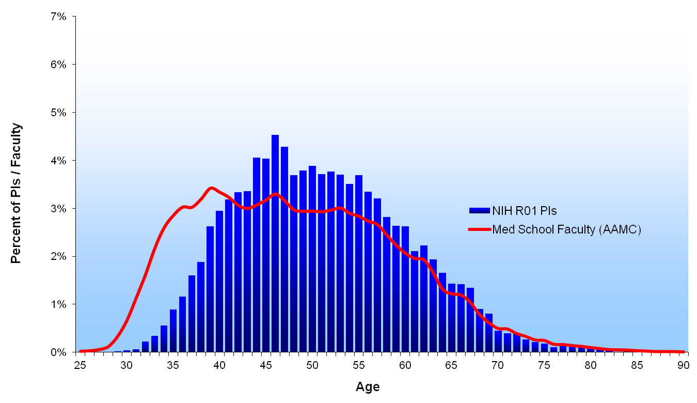
2009

Slide 35
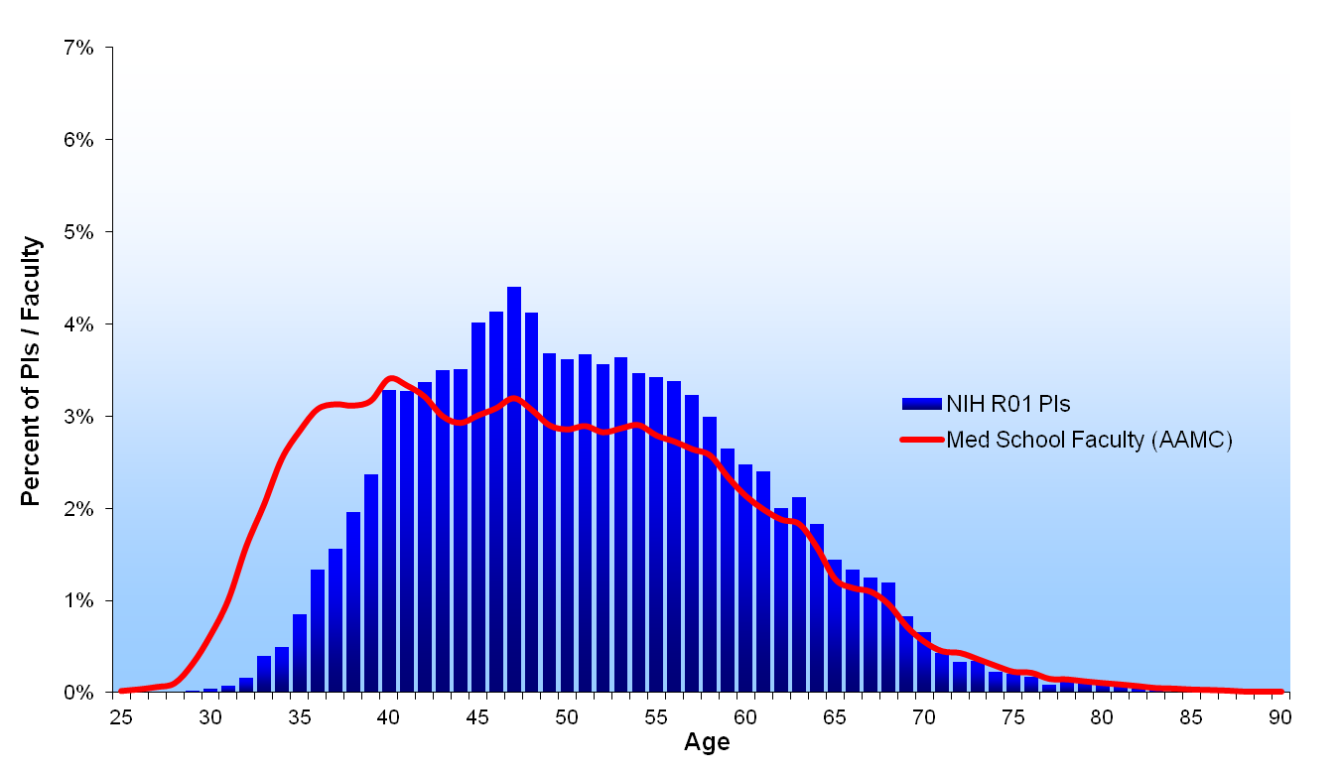
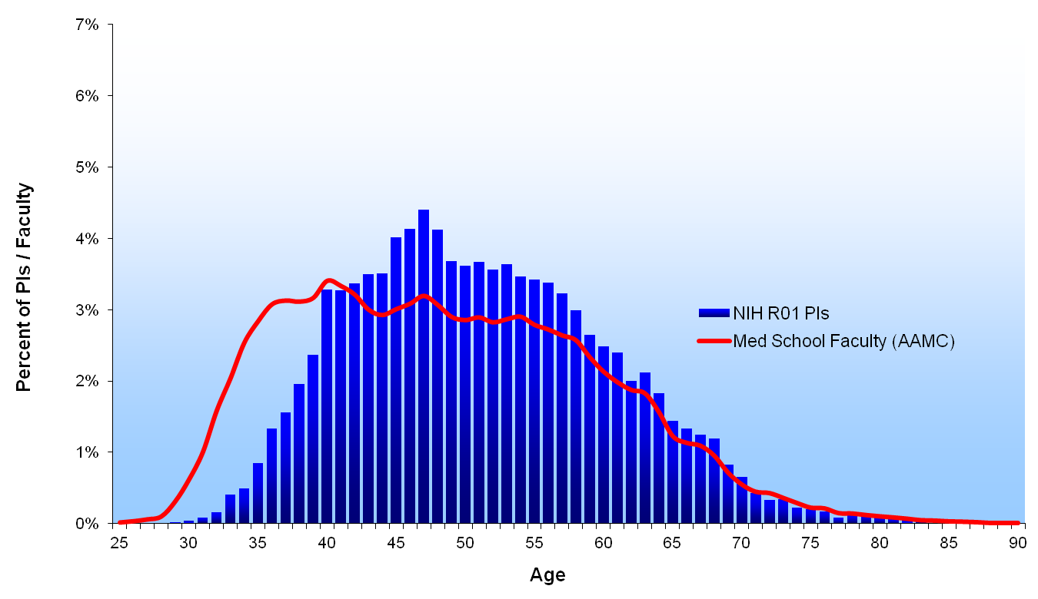
2010

Slide 36
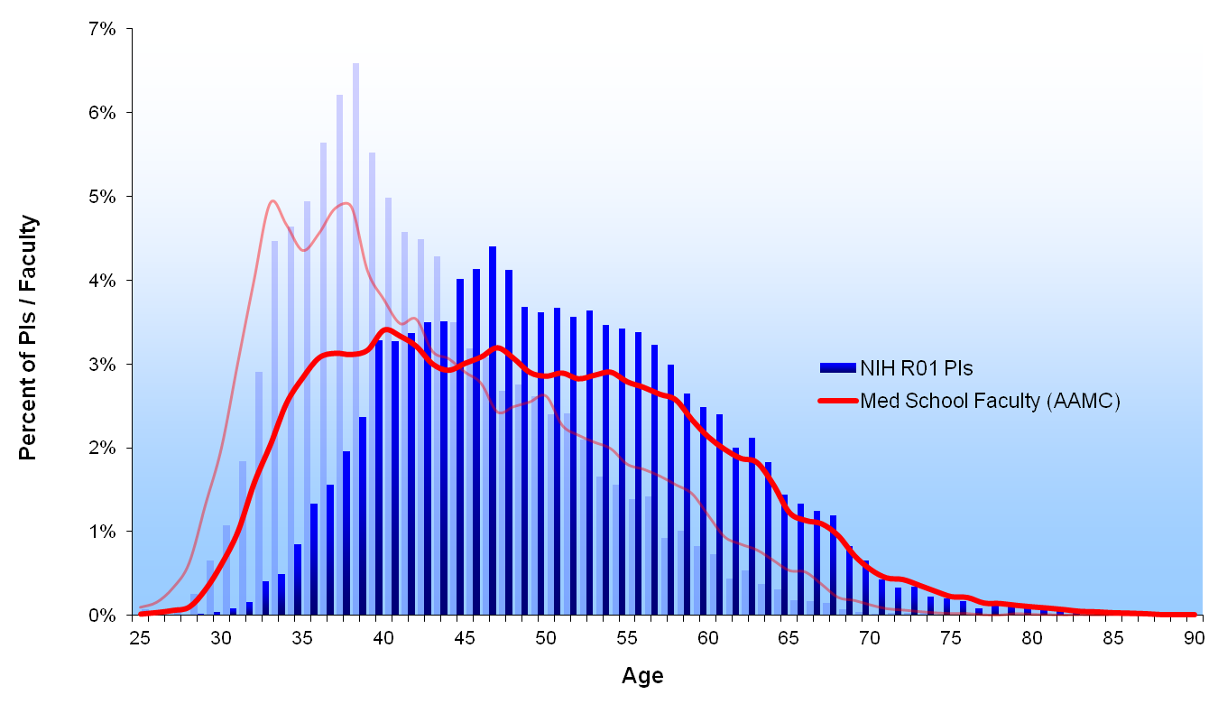
1980 & 2010
1980
2010
http://nexus.od.nih.gov/all/2012/02/03/our-commitment-to-supporting-the-next-generation/

Slide 37
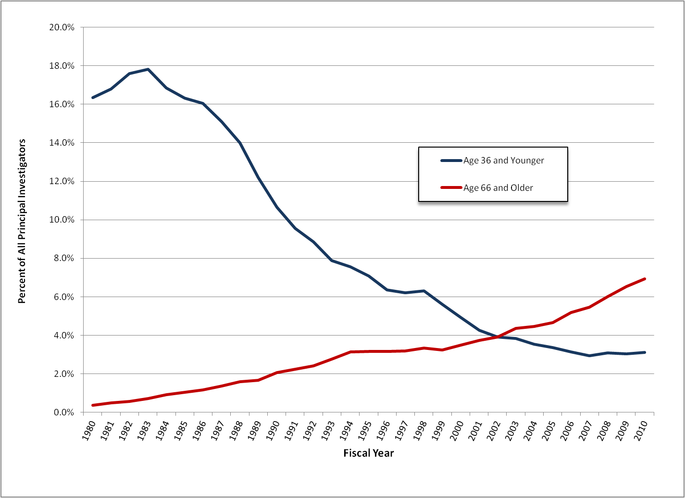
Percentage of NIH R01 Principal Investigators Age 36 and Younger and Age 66 and Older (Fiscal Years 1980 to 2010)

Slide 38
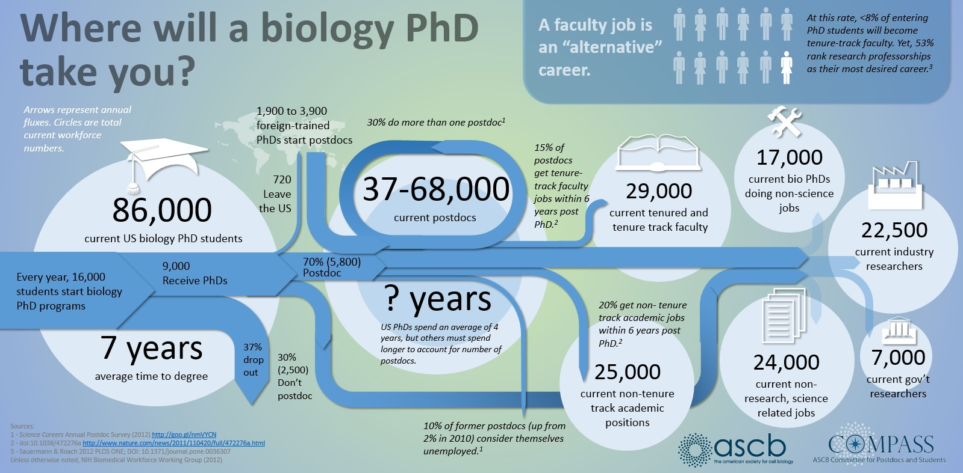
Scientific Career Paths

Slide 39
Alternative PhD Careers
Most people will not get tenure track positions, so the alternative is the majority. Some do not need postdoc, so check with people in the field.
Pharma and biotech companies
Consulting
Science communication
Science policy
Sales
Small business/entrepreneurship
Program officers/grant administrators
Government jobs usajobs.gov
NIH intramural program positions

Slide 40

Transition from Training to Independence
How do you stand out in the crowd?
A PhD should be used to place you into the best postdoc position
A postdoc should be used to place you in the most competitive faculty position

Slide 41
Things I Want to Talk About
Choosing a postdoc is the single most important decision(s) of your scientific career
With whom?
Where?
On what?
After the postdoc, how to start the job search

Slide 42
With Whom?
Postdoctoral mentor is extremely important. Things you should look into…
History of placing postdocs into faculty positions
Publication rate (how many papers do most postdocs get during their tenure)
How many of their trainees get F/K-awards
Are there a limited number of trainees that succeed a lot and a bunch that “disappear”
Contact former trainees and ask about their experience

Slide 43
Why Does the Advisor Matter?
A great mentor in a limited place is better than a crappy mentor in a great place
Will they let you fail your way into independence?
Do they have pre-cooked projects to get started on?
Can they devote time to mentoring you as a scientist
Will they allow you to write fellowships
How will they interact with you when you are gone
Notes:
Talk about my experience with Saltiel
Every time im introduced im saltiel’s guy

Slide 44
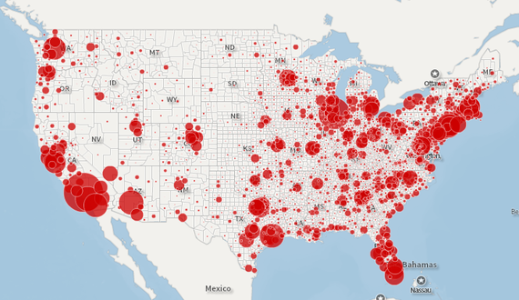
Where to go?
Should I go to another city, or another country
If I’m moving where should I move
http://www.theatlantic.com/business/archive/2013/12/the-south-is-americas-high-school-dropout-factory/282480/

Slide 45
What to work on
Keep working on the same type of thing
Can publish more quickly
Limiting long term
May be attractive to advisor
Work on something completely different
Burden on postdoc lab to teach you how
Slower path to data and papers
Hybrid model
Do something quick, that you know how to do
Then force yourself out of your comfort zone

Slide 46
What Do You Need To Achieve in Your Postdoc
Papers
Papers
Learn how to develop and co-ordinate a project
Proof of fundraising ability
Develop a scientific network
Cultivate collaborations
Go to meetings
Find mentors at your stage, and at a senior stage

Slide 47

Important Milestones in Postdoc Training (ie Fellowships)
F32 Eligibility – 2 Years from PhD
K99 Eligibility – 5 Years from PhD
K01/R03 Eligibility – No Time Limit for some institutes, < 5 years for others
Be aware of field-specific awards (Foundations, institutes and charities)
For more information
K Awards http://grants1.nih.gov/training/careerdevelopmentawards.htm
F Awards http://grants1.nih.gov/training/F_files_nrsa.htm

Slide 48
What Does Getting a Fellowship Mean
Varies by mentor, so ask
In most cases it means:
More money in your pocket
More independence on your project
A clear roadmap of your training and research plan
Proof of ability to raise funds going forward

Slide 49
Things I Learned as a Postdoc
Super Useful Things I Learned
Things I Didn’t Learn
What is the key question and is it worth asking?
How to design the best possible experiment
Understanding the conceptual framework behind the experiment
These are important years in your life
How to hire people
What is a budget, how much money should I spend and how quickly?
When to say no to collaborations
How to integrate my research into a larger thematic group

Slide 50
If a postdoc is a means to an end, what is that end

Slide 51
How Did My Job Search Go?
Deciding what I wanted to independently research?
Where should I apply?
What did they want to know about me?
Notes:
Needed research plan separate from my supervisor, but close enough that I knew what I wanted ot know
Sent out 37 applications, had 8 phone interviews, 7 onsite interviews and 6 job offers

Slide 52
What Are Hiring Committees Looking For?
Return on investment, can you get grants
Filling a specific niche
Can you teach a class they need taught
Is there a technique you bring to bear
Are you part of a core team, or starting a new area
Can they explain what you bring to the table in one sentence
Notes:
Talk about indirect costs and startup
(he is the guy that does that thing)

Slide 53



Famous Examples
James Watson?
DNA Discovery Guy
Stanley Prusiner?
Prion Guy
Thomas Hunt Morgan?
Fly Genetics Guy

Slide 54



Internationally Recognized Examples
Dario Alessi
How does Akt get activated?
Regulation of protein kinase guy
Rudi Aebersold
How can we measure proteins?
Identification of proteins/modifications guy
Stu Kornfeld
How do proteins traffic to the lysosome?
Intracellular protein transport guy

Slide 55
So How Do I Become The Guy?
Publish in the field – NO exceptions!
Create a niche and be generous
Go to meetings/give talks/meet people as you, not as a representative of your lab
Bring new methodologies to old ideas
Think outside the box
Get funded to do the work

Slide 56
#1 Path to Success
Review papers and grants
Sit on committees
Help people think about their projects
Edit papers for friends
Do the experiment nobody else will do
Go to work on the weekend
Take an undergrad in the lab
Present your research at meetings
STOP SAYING NO!

Slide 57
How to present yourself
Use the internet.
Present yourself online and maintain control over your own CV and publication record:
Google Scholar - http://scholar.google.com
ORCID - http://orcid.org/
Engage on social media (twitter/reddit/message boards)
Set up a simple website highlighting your accomplishments, independent of your mentor
Notes:
USAjobs.gov

Slide 58
Networking is important
Start early, at conferences and meeting speakers
Informational interviews with folks in field
What is job about
What is required
What do I need to do to get the job
Might get leads for jobs that are down the pipe

Slide 59
Make a plan
No one is going to plan your life for you
Good tools are available online:
http://myidp.sciencecareers.org/
Talk with people you trust: mentors, family, coworkers

